Slide 1
RISCV with floating Point
SUBMITTED BY :
AbdelRahman Atef Eid Yassin
Mahmoud Mohamed Taha
Ahmed Khattab Mahmoud Khattab

Slide 2
OUTLINES
OBJECTIVE
Instruction Set Architecture
IEEE Floating point Standard
Floating Point Unit Design
Integrating With RISCV
Floating Point System
Connection with RISC V
Testing and Results
References

Slide 3
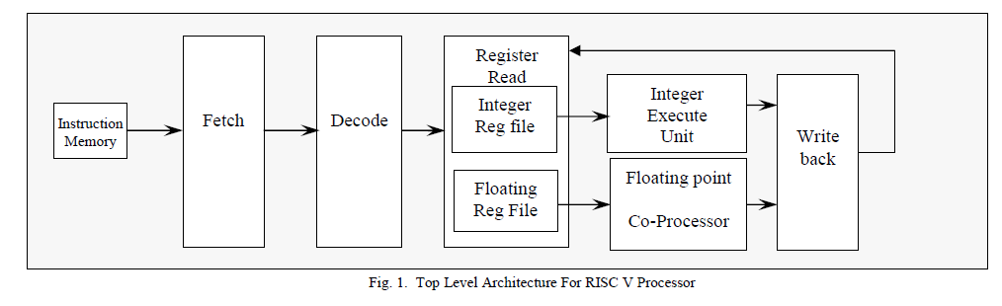
OBJECTIVE
The aim of this is project is to extend RISC V processor to be able to deal with floating point instructions .
STEPS
1- Instruction Set Architecture study
2- Design FPU unit that deals with floating point numbers
3- Integrate it with RISC V
ISA study
Design FPU
RISC V
Integration

Slide 4
Instruction set ARCHITECTURE
31-25 | 24-20 | 19-15 | 14-12 | 11-7 | 6-0 | Instruction | illustration
Imm[11:0] |  | rs1 | 010 | rd | 0000111 | FLW | Load a value from location rs1 (integer reg) + imm to rd (float reg)
Imm[11:5] | rs2 | rs1 | rm | Imm[4:0] | 0100111 | FSW | store a value from rs2 (float reg) +memory( imm + rs1)
0000000 | rs2 | rs1 | rm | rd | 1010011 | FADD | Rd = r1 + r2 all float registers
0000100 | rs2 | rs1 | rm | rd | 1010011 | FSUB | Rd = r1 - r2
0001000 | rs2 | rs1 | rm | rd | 1010011 | FMUL | Rd = r1 * r2
0010100 | rs2 | rs1 | 000 | rd | 1010011 | FMIN | Rd = min (rs1,rs2)
0010100 | rs2 | rs1 | 001 | rd | 1010011 | FMAX | Rd = max (rs1,rs2)
1100000 | 00000 | rs1 | rm | rd | 1010011 | FCVT.W.S | Convert float in rs1(float) to integer in rd(integer)
1101000 | 00000 | rs1 | rm | rd | 1010011 | FCVT.S.W | Convert int in rs1 (int) to float in rd(float)
1110000 | 00000 | rs1 | 000 | rd | 1010011 | FMV.X.W | Move float number from rs1 (float) to rd (integer)
1111000 | 00000 | rs1 | 000 | rd | 1010011 | FMV.W.X | Move int number from rs1 (int) to rd (float)
1010000 | rs2 | rs1 | 010 | rd | 1010011 | FEQ.S | Rd = 1 (integer) if rs1 == rs2 (float)
1010000 | rs2 | rs1 | 001 | rd | 1010011 | FLT.S | Rd = 1 (integer) if rs1 < rs2 (float)
1010000 | rs2 | rs1 | 000 | rd | 1010011 | FLE.S | Rd = 1 (integer) if rs1 <= rs2 (float)
1110000 | 00000 | rs1 | 001 | rd | 1010011 | FCLASS.S | Classify floating point

Slide 5
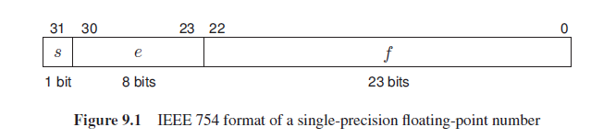
IEEE 754 floating Point Standard
Floating numbers
Sign
normalized
denormalized
+0,-0
+INF,-INF
nan
S=0 (Positive)
S=1 (Negative)
e=255
F!=0
0<e<255
e=0
F!=0
e=0
F=0
e=255
F=0
Number is presented as
For a normalized number, the 1 of 1. f is not stored in the 32-bit data; it is called a hidden bit. For a
denormalized number, the hidden bit is a 0.
-9.75 > - 1001.11 = - 1.00111 x 2^3
S= 1
E= 127 + 3 = 130 = 1000 0010
F = 00111 00….00

Slide 6
Top level
The floating point co-processor will accepts input signals as three input
1- operands (single precision)
2- opcode
3- round mode.
It decodes instructions and executes them

Slide 7
Floating point unit
a
R1
R1
FPU_decode[3:0]
FPU Floating Point Unit is implemented as top module in FPU.v
FPU_decode[3:0]
b
ADD/SUB
NV1
R2
frm
OF1
R3
result[31:0]
sub
UF1
R4
NX1
R5
a
R2
R6
A[31:0]
F2I
NV2
R7
OF2
R8
UF2
R9
NX2
NV1
B[31:0]
a
I2F
R3
NV2
Invalid
NV3
NV3
UF3
NV4
NX3
NV5
Frm[2:0]
a
R4
NV6
b
FMUL
NV4
frm
OF4
UF4
sub
a
NX4
OF1
b
Compare
R5
OF2
OF
frm
NV5
OF4
a
Min/Max
R6
b
NV6
frm
UF1
a
R7
UF2
UF
Classify
UF3
frm
UF4
FDIV
R8
DZ
NX1
NX
NX2
R9
NX3
FSQRT
NX4
NX5
NX6

Slide 8
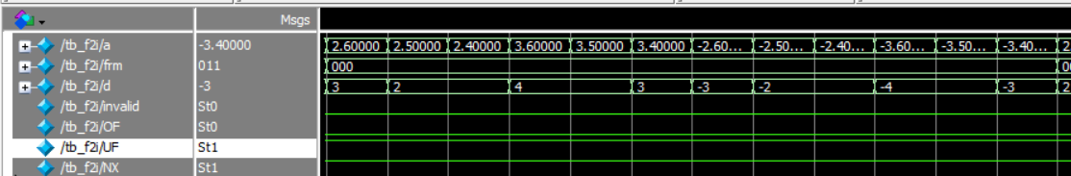
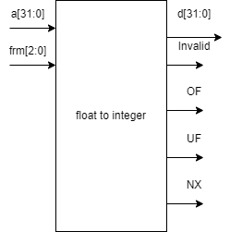
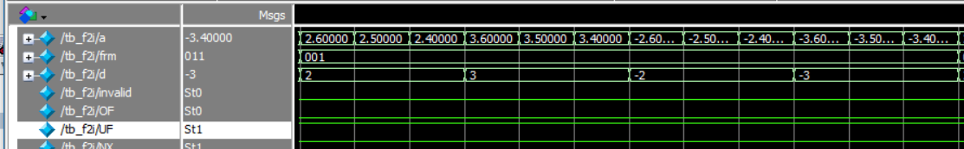
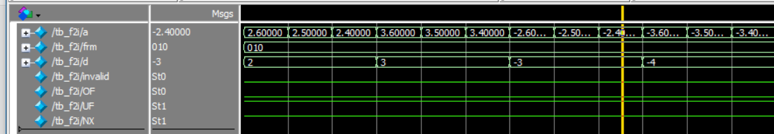
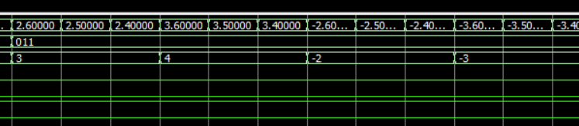
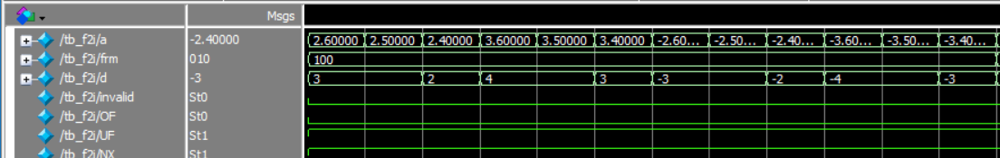
Float to integer
Calculate hidden bit and determine if mantissa is not zero
Determine if number is denormalized or zero
Determine the sign
Put hidden bit at left then 23 bits of f then Shift right by 158 – e
If there is a value at least 23 bits there is precision loss
If sign is negative ,takes two’s complement
Output UF =1 if it is denormalized or precision lost
Output OF =1 if a value more than 32 bits
Output invalid in case invalid conversion of a bigger result
1bit
23 bits
32 bits
hb
f
zeros
Shift right by 127+31 - e
Rounding mode | meaning
000 | RNE
001 | RTZ
010 | RDN
011 | RUP
100 | RMM
A 32-bit single-precision floating-point number has a much wider range than the integer.
This means that many floating-point numbers cannot be converted to integer correctly

Slide 9
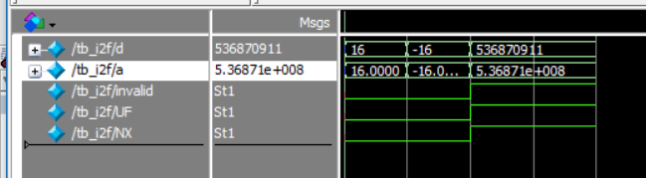
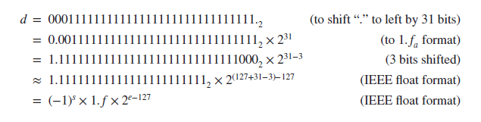
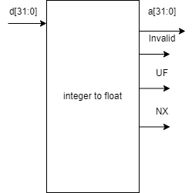
Integer to float
Shift the point by 31 bits
Normalize to 1.xx format
Calculate shift amount
Determine the sign
Calculate exponent =158-sa
Output invalid flags if some values are thrown away by shift

Slide 10

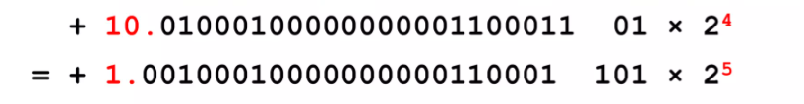
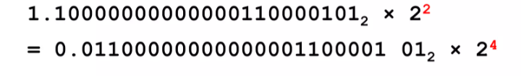
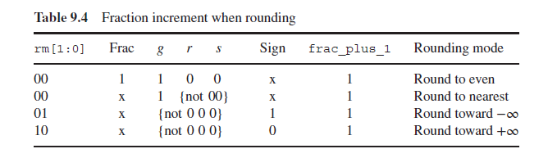
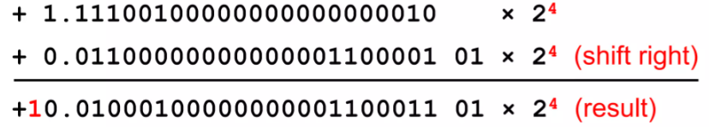
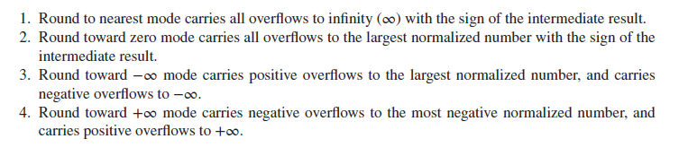
Floating point addition and subtraction
1- determine who is largest a or b
4- normalize result
2- make exponent equal by shifting the smallest one (difference between exponents)
5- rounding result (least 5 bits 01 101) grs = 01 1
g is guard bit ,r is rounding bit , s is sticky bit (or last 3bits)
3- add them together according to add or sub
6- normalize again after rounding (adding 1)
7- if exponent reaches max value it is overflow

Slide 11
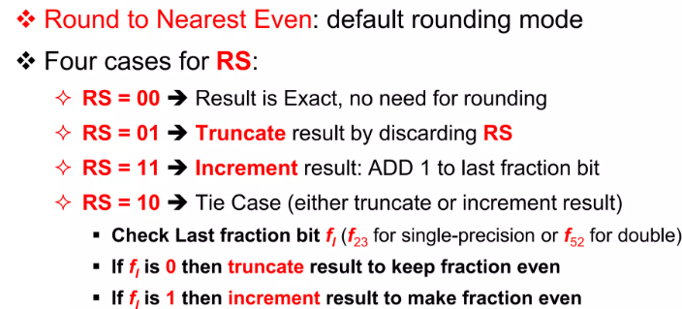
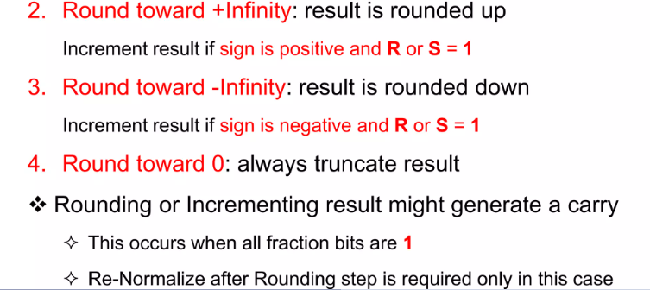
ROUNDING

Slide 12
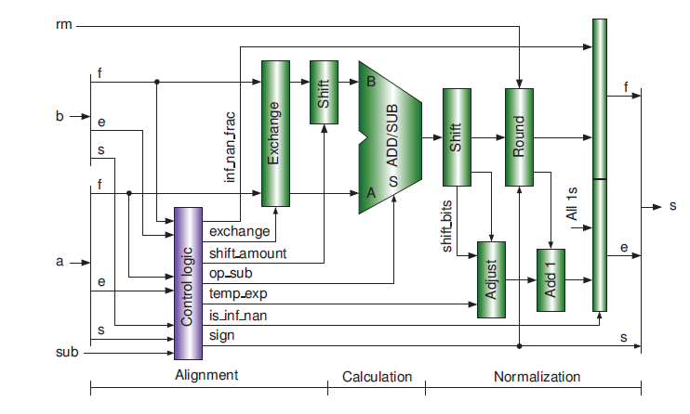
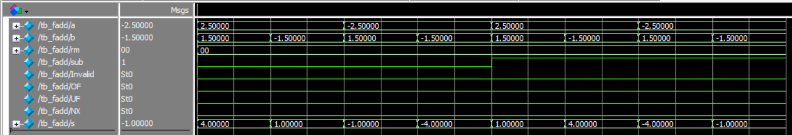
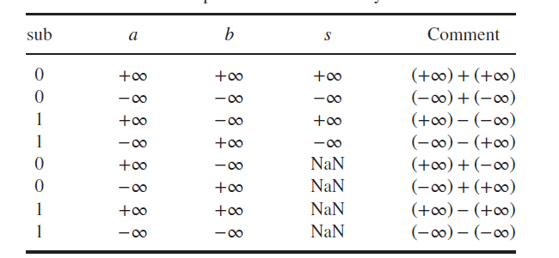
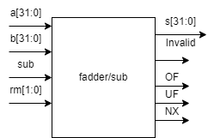
Floating point addition and subtraction

Slide 13

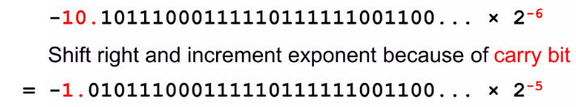
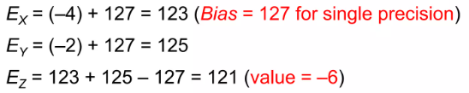
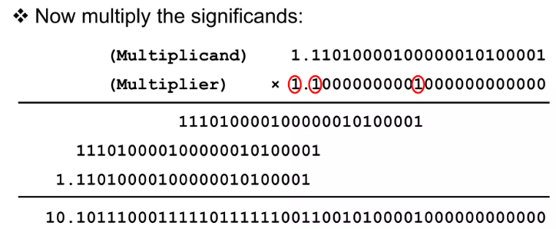
Floating Multiplier
1- exponent of result is addition of both exp + bias
4- normalize result
6- rounding (takes only 23 bits according to same rounding function
2- sign of result is xor of both
3- multiply the fractions together (Wallace tree)
Hidden bit + 23 bit by Hidden bit + 23 bit

Slide 14
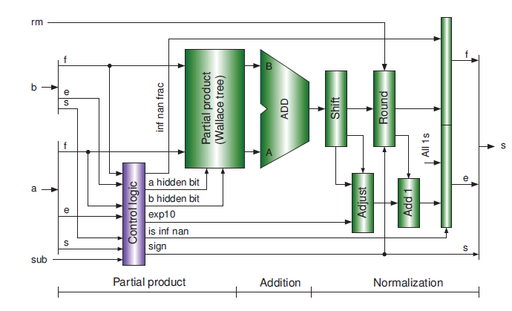
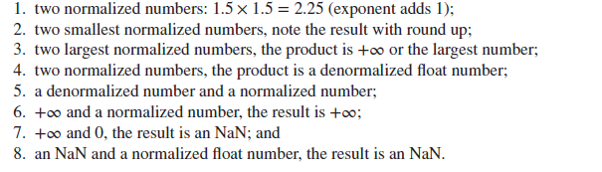

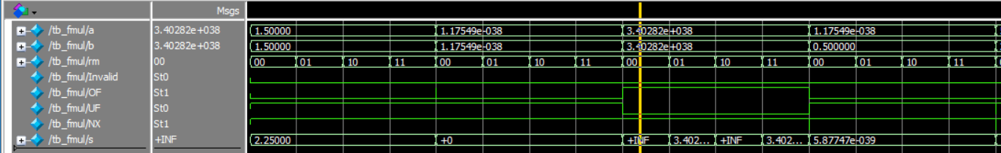
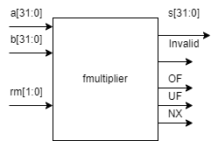
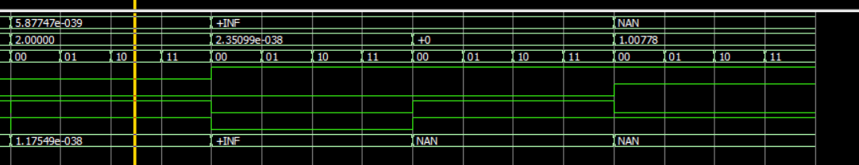
Float multiplier

Slide 15
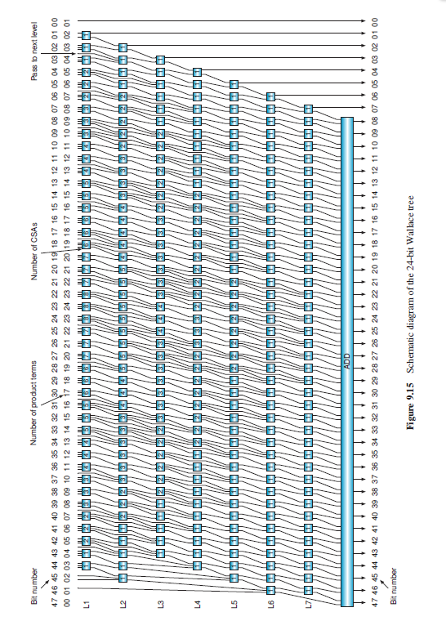
Wallace tree multiplier

Slide 16
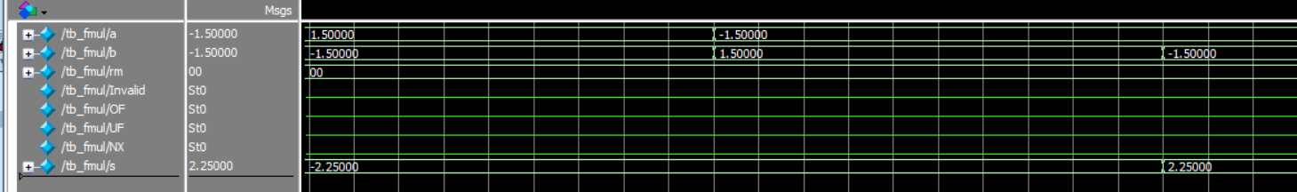
Check sign

Slide 17
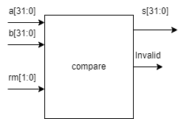
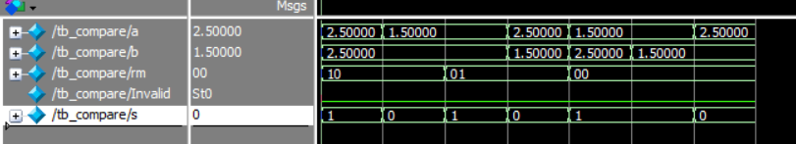
Comparison
rm | output
10 (equality) | =1 when a == b (sign ,exp,mantissa)
01 (less than) | Check if different signs if a is - ,output = 1 If same sign , output = 1 when exp(a) < exp (b) and if equal check mantissa
00 (less than or equal) | Check if different signs if a is - ,output = 1 If same sign , output = 1 when exp(a) <= exp (b) and if equal check mantissa
Check exponent and mantissa to be zeros or all ones
Determine if any of number is nan or invalid
If numbers are valid, compare the numbers

Slide 18
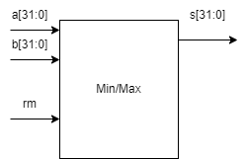
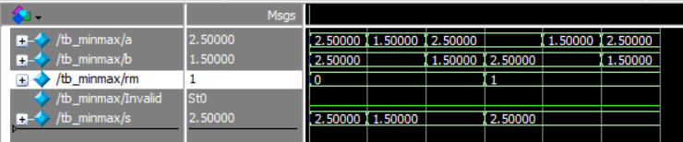
Min max
rm | output
0 (min) | Check sign if different signs ,output is the negative number If same sign output operand with the least exponent If same exponent output operand with the least mantissa
1 (max) | Check sign if different signs ,output is the positive number If same sign output operand with the largest exponent If same exponent output operand with the largest mantissa
Check exponent and mantissa to be zeros or all ones
Determine if any of number is nan or invalid
If numbers are valid, compare the numbers
Invalid

Slide 19
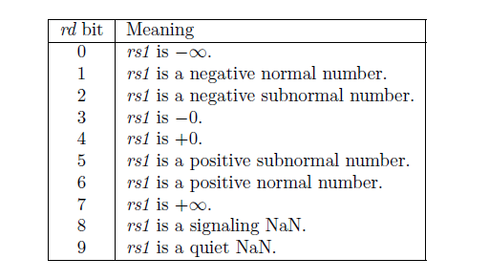

Classify
Quiet nan if exponent all ones and mantissa has a leading zero and any one
Signaling nan if exponent all ones and mantissa has a leading one
Normal number has one in bit 23 of mantissa ,subnormal has zero

Slide 20
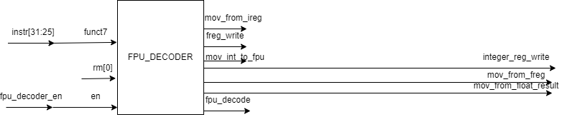
FPU DECODER
Data out from
fpu to int reg
Data out from
int reg needed as operand to fpu
Write enable of freq and integer reg
Funct7 7bits | Fpu decode | rm | Mov from f reg | Mov from i reg | Freg_write | Integer_reg_write | Mov_from_float_result | Mov int to fpu | Instruction
0000000 | 0000 | X | 0 | 0 | 1 | 0 | 0 | 0 | Add
0000100 | 0000 | X | 0 | 0 | 1 | 0 | 0 | 0 | Sub
1100000 | 0001 | X | 0 | 0 | 0 | 1 | 1 | 0 | f2i
1101000 | 0010 | X | 0 | 0 | 1 | 0 | 0 | 1 | i2f
0001000 | 0011 | X | 0 | 0 | 1 | 0 | 0 | 0 | mul
1010000 | 0100 | X | 0 | 0 | 0 | 1 | 1 | 0 | compare
0010100 | 0101 | X | 0 | 0 | 1 | 0 | 0 | 0 | minmax
1110000 | 0110 | 1 | 0 | 0 | 0 | 1 | 1 | 0 | classify
1110000 | 1111 | 0 | 1 | 0 | 0 | 1 | 1 | 0 | Move float to int
1111000 | 1111 | X | 0 | 1 | 1 | 0 | 0 | 0 | Mov int to float

Slide 21
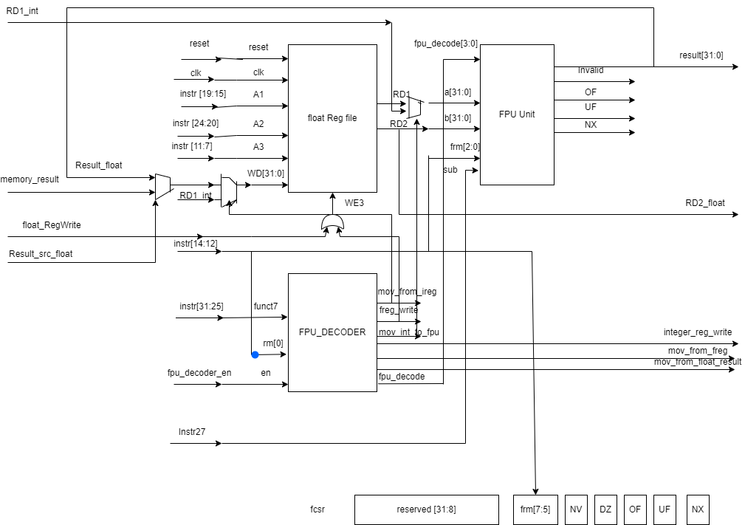
Floating point system

Slide 22
RISC V edited
The Main Decoder of RISC V is edited so the control unit to allow Float instructions
Instr[6:0]
Main Decoder
float_RegWrite
float_store
fpu_decoder_en
ResultSrc_float
Opcode | Instruction | float_RegWrite | float_store | fpu_decoder_en | ResultSrc_float
0000111 | load | 1 | 0 | 0 | 1
0100111 | store | 0 | 1 | 0 | 0
1010011 | Rest of RISCV 32F | 0 | 0 | 1 | 0

Slide 23
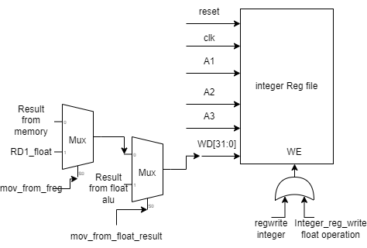
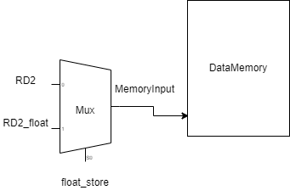
RISC V edited

Slide 24
Testing Instructions
Instructions | Initial values | Expected Output
Sw $f1,4($x1) | X1 = 4 , memory[2] =2,$f1=2.5 | Memory[2]=2.5
Lw $f25,4($x1) | $f25= 1124.53 | $f25=2.5
Add $f3,$f1,$f2 | $f1=2.5 $f2=2.6 | $f3=5.1
Sub $f31,$f16,$f15 | $f16=4.75 $f15=2.25 | $f31=2.5
MUL $f28,$f1,$f4 | $f1=2.5 ,$f4=-3.5 | $f28 = -8.75
MIN $f30,$f28,$f29 | $f28=-8.75 $f29=10500.5 | $f30 = -8.75
MAX $f30,$28,$f29 | $f28=-8.75 $f29=10500.5 | $f30 = 10500.5
F2i $x5,$f17 | $f17 =2.147483520*10^9 (4eff ffff) | $x5=2147483520(7fffff80)
I2f $f26,$x1 | $x1 = 4 | $f26=4.0
Mov $x8,$f12 | $f12 = 0000ffff | $x8 = 0000ffff
Mov $f25,$x7 | $x7 = 0000 0028 h | $f25 = 0000 00028 h
FEQ $x2,$f21,$f21 | $f21 = 530.125 | $x2=1
FLT $x3,$f3,$f2 | $f3= 5.1 $f2 =2.6 | $x3=0
FLE $x4,$f3,$f2 | $f3= 5.1 $f2 =2.6 | $x3=0
FCLASS $x10,$f9 | $f9 = +INF | $x10 =0000 0080

Slide 25
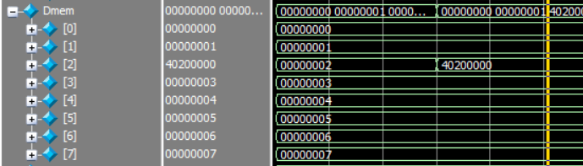


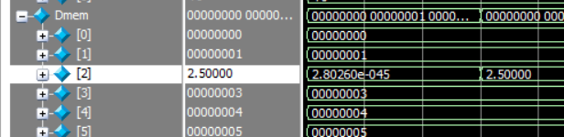
Testing store instruction

Slide 26
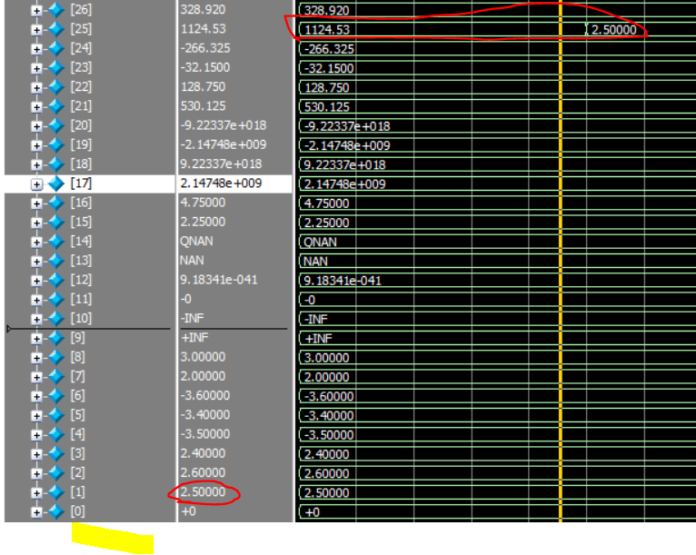
Testing load instruction

Slide 27
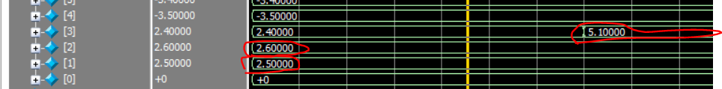
Testing ADD Instruction

Slide 28
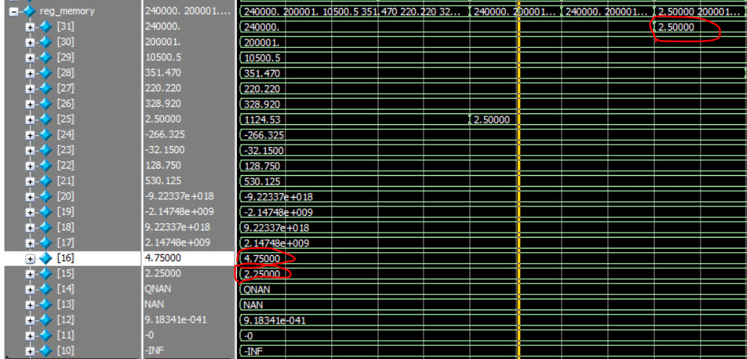
TESTING SUB INSTRUCTION

Slide 29
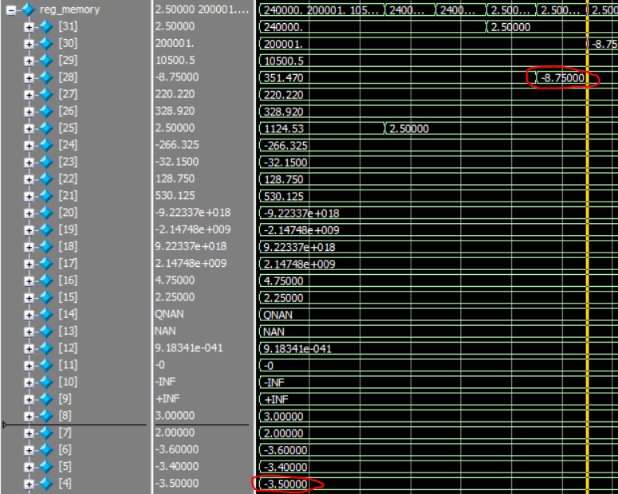

Testing mul instruction

Slide 30
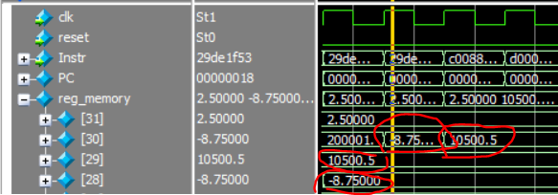
Testing Min & MAX

Slide 31


TESTING F2I

Slide 32
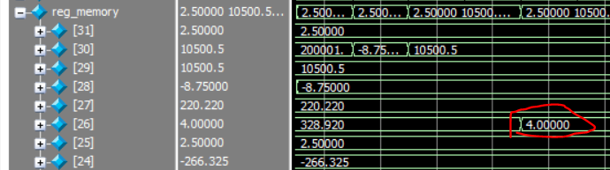
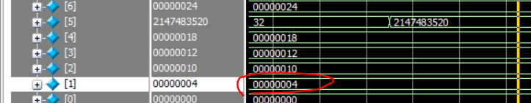
TESTING I2F

Slide 33




Testing mov instructions

Slide 34


TESTING COMPARE INSTRUCTIONS

Slide 35


TESTING CLASSIFY

Slide 36
References
The RISC-V Instruction Set ManualVolume I: User-Level ISADocument Version 2.2Editors: Andrew Waterman1, Krste Asanovic1;21SiFive Inc.,2CS Division, EECS Department, University of California, Berkeleyandrew@sifive.com, krste@berkeley.eduMay 7, 2017
COMPUTERPRINCIPLESAND DESIGN IN VERILOG HDL Yamin LiHosei University, Japan
https://www.slideshare.net/prochwani95/06-floating-point

